Slide 1
Enterprise Application Requirements
Application that needs to change its “look” frequently
Partition the application as per the presentation and business logic for modularity, manage-ability and maintainability
Deploy the application across multiple platforms (hardware / software) independently of the underlying database technology
Enable more loosely-coupled development with off-the-shelf business logic components
Notes:
Services provided by enterprise software are typically for business-oriented functionalities such as online shopping and online payment processing, interactive product catalogue, automated billing systems, security, content management, CRM (Customer Relationship Management), ERP (Enterprise Resource Planning), Business Intelligence, HR Management, Manufacturing, EAI (Enterprise Application Integration) etc.
So, in all EAs solve business problems of enterprise
Involves safe storage, retrieval and manipulation of production data
Can have multiple user interfaces like Web UI, Desktop UI, PDA Display
Without having to make assumption about the consumer of data, we can make applications, using concepts like, i18n (internationalization), and l10n (localization)

Slide 2
Enterprise Application Requirements…
Business processes and/or applications that need to be accessed from corporate network, intranet as well as over internet
Needs to be reliable, robust, and grow with business
Provide user-friendly functionalities and user interface
Handle huge data and complex business rules
Follow stringent security requirements of corporate / business
Notes:
Communicate with remote systems
Has to co-ordinate data in multiple and disparate data sources
Ensures application follows business rules
Should provide security, scalability and reliability
Should be robust and needs to grow with business

Slide 3
Enterprise Application Software
It is an application software, that performs business functions such as accounting, production scheduling, customer information management, bank account maintenance, etc.
It is frequently hosted on servers and simultaneously provides services to a large number of users, over a computer network
Typically it has n-tier architecture
Notes:
This is in contrast to the more common single-user software applications which run on a user's own local computer and serve only one user at a time.
Analyze and compare:
DART
makemytrip.com
PRS (Public Reservation system )

Slide 4
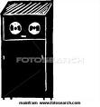
Evolution of Enterprise Applications - Single Tier
Dumb Terminal 1
Dumb Terminal 2
Dumb Terminal 3
Contains Business logic, Presentation logic and data access
Mainframe
Clients used only for data gathering and output display
Easy to manage - client side management is NOT required
Data consistency is easy and simple to achieve, as all components at one place
As application size grows, difficult to maintain and reuse
Notes:
This slide is intentionally hidden and has to be used by the participants for more clarification on this topic
Ex- Simple software applications written to run on single computer.
All services provided by the application like – the UI, the persistent data access and logic to process the user input is present on same physical machine, lumped together into the application.
This monolithic architecture is called – Single Tier
Explanation--- for Advantages
1) Clients to Single tier EAs have only dumb terminals. Presentation logic, Business logic and Data Access logic resides at single place, mostly on mainframes. All these layers are tightly coupled to each other. Any change in them(logic), requires NO change at client side.
So, NO client side management is required.
2) As data is stored at single location, integrity and consistency of data is easy to achieve.
Disadvantages
Do not scale up to handle multiple users
No easy means to data sharing across enterprise
All these layers are tightly coupled to each other, any change happening to any of the layers, will affect other layers as well. So difficult to maintain and reuse.
Again, for maintenance, we may require people who have skill sets in different areas such as Presentation + Developing Business Logic + Data Access logic; which is difficult to get.

Slide 5


Evolution of Enterprise Applications - Two Tier (Client/Server)
Database Server
Data Access Layer
Business Logic and
Presentation Logic Layer
Order fulfillment Application accessing Customer Information
Customer care operations accessing same Customer DB
Database product independence
Difficult to maintain and update
Notes:
This slide is intentionally hidden and has to be used by the participants for more clarification on this topic
Ex- Database storing the customer information on the database server, and order fulfillment application is accessing it.
Advantages –
In Two tier EAs, the Data Layer is separated from the Business and Presentation logic, which give Application (also called App) developers flexibility to maintain database independently. Changes or migration in this layer will be independent and can be taken care of efficiently.
Data is centralized, so multiple users can use it simultaneously with common database
Database server can share some workload associated with running the application.
Disadvantages-
1. Business and presentation logic resides together at Client side, this applications are difficult to maintain and update.
Ex: Consider the app is deployed at 50,000 clients. Any change in Presentation (frequent) or business rules (less frequent) will have to be managed/ updated at all 50,000 clients, which is difficult to achieve.
And again there would be too much inter-dependence between Presentation and Business logic, which leads to poor maintenance capabilities.
2. Same reason poses a problem, when multiple applications share the same database.
Ex-Consider, another applications such as invoicing/customer resource management applications are using the same customer information database. All these applications would need to be built with all of the logic and rules to manipulate and access the customer data. Change to any rule, would mean updating each application…

Slide 6

Evolution of Enterprise Applications - Three Tier
Database Server
Presentation Logic Layer
Business Logic
Data Access Layer
Example – DART Application
Business logic can change more easily
Complexity introduced in the middle tier
Notes:
This slide is intentionally hidden and has to be used by the participants for more clarification on this topic
In 3-tier EAs, Presentation, Business and Data layers are separated and kept at different locations. This will ease maintenance of any of the layers without other layers getting affected.
Here, still we need to deploy the presentation logic at each and every client separately, which will be difficult to achieve, once presentation logic changes. (Not a scalable model)
Business logic exists at middle-tier also known as Application Server or “app server”. There are various system-level issues related to the working of the middleware, such as –
1.When is this server supposed to create instance of the servlet? At the startup time or after first request comes in?
2.Can it connect to database with single connection object? No. Then, if we have to create multiple connections, can we keep it as pool of connections? What should be its size?
3.Should it support single thread model or Multi-threading is inherent?
4. In that case, how many threads should be created and kept ready in a thread-pool?
So all these issues add up the complexity in the middle tier, which needs to be answered.

Slide 7
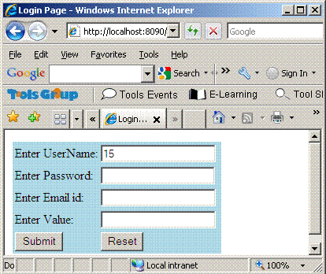
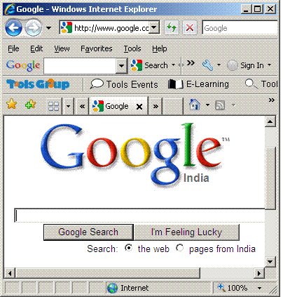
Evolution of Enterprise Applications - n Tier
Database Server
Presentation Logic
Business Logic
Data Access Layer
Thin Clients
Example - Wep Apps on Sparsh, like Leave System , Harmony
More loosely coupled
More reusable
Zero client management
Complexity in the middle tier
Notes:
This slide is intentionally hidden and has to be used by the participants for more clarification on this topic
In N-tier EAs, most of the discussed issues are resolved…
The Presentation, business and data layers are separated and are located on separate server components.
Users access the applications using thin clients. Thin clients are the clients, which do not have any application logic residing at the local machine. At client side, no special requirements are needed.
Example of thin client : Web browser
Now, even if your web sites presentation logic is changing every week (this was happening for yahoo mail sometimes back) , no client side management is required. You can change it at only one place (i.e in your server where your site’s presentation logic resides)!
But as the middle-tier component exists in this architecture, so issues relating to it will still remain in this model, which can be thought as disadvantage!!!

Slide 8
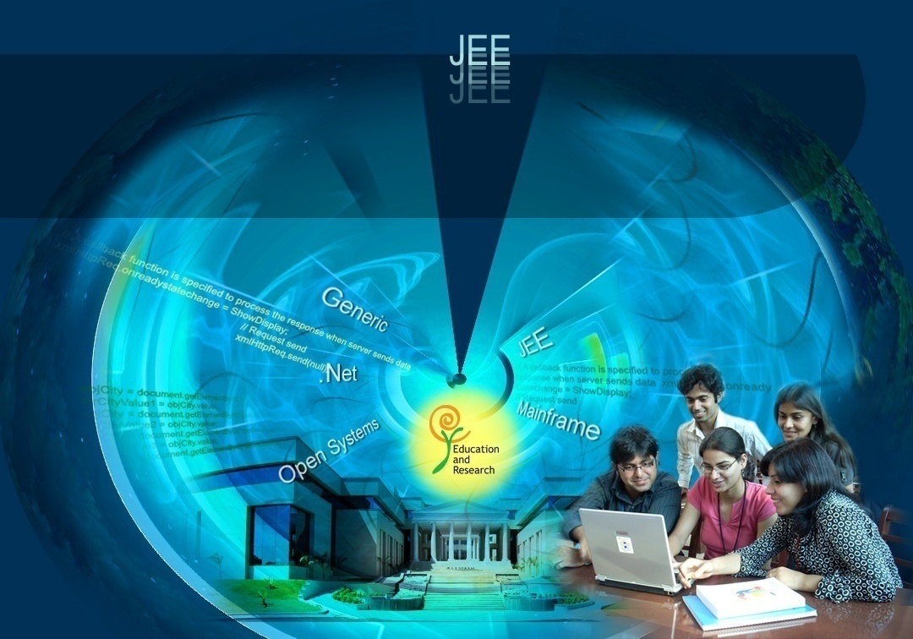
Recap- Web Technologies
Education and Research
We enable you to leverage knowledge anytime, anywhere!
ER/CORP/CRS/ED113/003
Ver. No.: 1.2
Confidential
Copyright © 2008, Infosys Technologies Ltd.
Notes:
An enterprise application will have various functional pieces/partitions, such as-
Presentation Logic – displaying stuff to user, collecting data from the user
Business Logic – makes the application work and handles the important processing
Data Access Logic -for reading and writing data from data source
This is referred as “architecture” of the Application, which is multi-tier, in above case

Slide 9
Working of Web Application: static content
User request for something to the web server
Web server search that content in its file system
If file found then server response that to the user otherwise “404 error file not found”
Simple Web server CAN NOT Do following:
Dynamically create pages which do not exist before the request
Write, manipulate or save data on the server
Notes:
Client request contains the name and address(the URL) of the thing the client is looking for.
Here browser format the client request in form of URL using HTTP protocol
Server’s response contains the actual document that the client requested (in form of HTML)

Slide 10
Working of a Web Application
Internet uses Client/Server technology for its working
The world wide web uses the Browser as the client software and Web Server as the server software
The user types the required URL in the browser
The IP Address of the Server is found from the URL
The Web Server will be listening in that Server (machine) at Port No 80
The browser connects to Port No 80 of the specified Server
Based on the request, the Web Server will deliver the appropriate page to the browser
Notes:
Telnet server use port 23
POP3 mail server use 110
FTP server use 21
SMTP use 25
These are server apps. Each apps per port.
A Server can have up to 65536 different server apps.
Web server – Apache Tomcat

Slide 11
HTTP Protocol
Hyper Text Transfer Protocol or HTTP is the protocol used by the world wide web to communicate
According to the HTTP protocol, the client should send a Request to the server in a special format
Based on the Request, the server will send back a Response, which again is in a special format
Notes:
Apache is an example of a web server that processes HTTP requests
HTTP response are in html format. It contain header and body. Header contain the info of what type of data the html contain.

Slide 12
HTTP Request
The following is the request generated by Internet Explorer when the URL was http://www.yahoo.com
HTTP Method
Request-URI
Protocol version
GET http://www.yahoo.com/ HTTP/1.0
Accept: image/gif, image/x-xbitmap, image/jpeg, application/vnd.ms-excel, application/vnd.ms-powerpoint, application/msword,application/x-shockwave-flash, */*
Accept-Language: en-us
User-Agent: Mozilla/4.0(compatible; MSIE 6.0; Windows NT 5.1)
Host: www.yahoo.com
Header
Notes:
The user types only the URL on the browser. But according to HTTP protocol, the request should contain some more information in a special format. Since the browser follows the HTTP protocol, it will automatically create the HTTP Request in the specified format using the URL typed by the user and adding the extra information as shown in this slide.
The first thing specified by a Request is a HTTP command called METHOD.
This tells the Server the kind of service you require.
This will be followed by the path of the document the browser requires and the version of HTTP used by the client

Slide 13
HTTP Request
There are various types of Methods, supported by HTTP protocol GET, POST, HEAD, TRACE, PUT, CONNECT, DELETE etc.
The client can send optional header to the server; to tell additional information about the request and about the client itself
The Header may contain:
Accept :The media types which are acceptable for the response
Accept-Lang: Preferred set of natural languages as a response
User-Agent: Information about the user agent originating the request
Host: Internet host and port number of the resource being requested
Etc…
At the end of Header information, the client should send a blank line to indicate the end of Header
The Header information helps the server to generate the response properly for that clientS
Notes:
GET is the simplest HTTP method where user ask server to send response.
Limited character can send to the server for searching.
Data appended with URL
POST method is use to send some data to the server and based on that get response from server.

Slide 14
HTTP Response
The server processes the request and sends a Response
The following is an example of a response
Status Line
HTTP/1.1 200 OK
Date: Sat, 18 Mar 2000 20:35:35 GMT
Server: Apache/1.3.9 (Unix)
Last-Modified: Wed, 20 May 1998 14:59:42 GMT
Content-Length: 2000
Content-Type: text/html
<HTML><HEAD> </HEAD> <BODY>
…
</BODY> </HTML>
Header
Message Body -Actual Data
Notes:
The first line of the Response is called the status line
The status line should contain the HTTP version, Status Code and a Status Description
The following are some examples of status code used by HTTP
100 – Continue (Request received, continuing process)
200 – Ok (Success)
301 – Moved Permanently (Redirection)
400 – Bad Request (Client Error)
401 – Unauthorized
403 – Forbidden
404 – Not Found
500 – Internal Server Error (Server Error)
After the status line comes the Response header
The software used by the server, content type of the response etc will be communicated to the browser using these headers
There should be a blank line to show that the header information is over
After the header, the server sends the data on success or an error description on failure

Slide 15
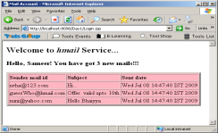
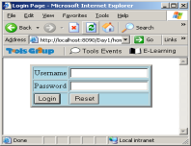
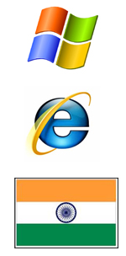

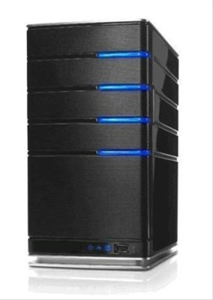
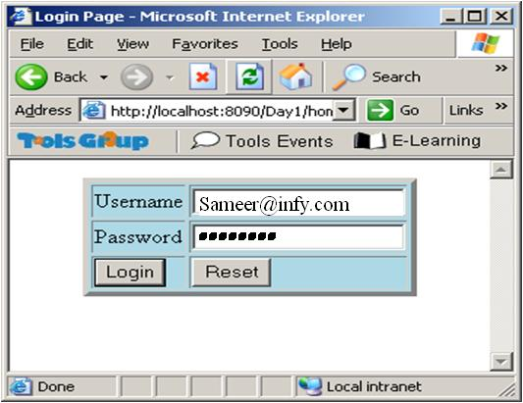

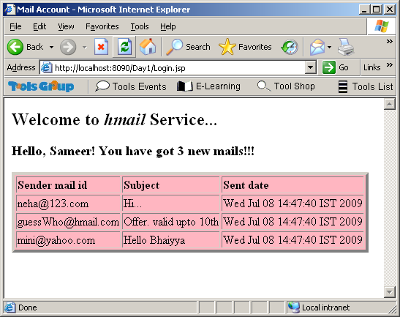

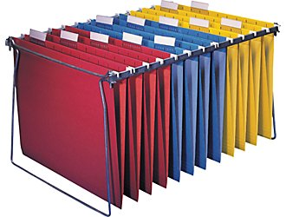
Generation of Dynamic Page
1
WEB server
3
2
WEB Container
File System
Server checks if this
request is for static
Content. If yes, then
retrieves from FS.
2.Otherwise, Web Server
forwards request to Web Container for Generating the response
3.Server sends the
Response back to
the client
1.Client sends a request

Slide 16
Static v/s dynamic pages
From the web, we get static pages as well as dynamic pages
Static Pages | Dynamic Pages
Can be created and stored in web server in advance as HTML file | Can NOT be created and stored in web server in advance as HTML file
Static pages do not change with user or time | Dynamic page changes as per the user and/or time.
For delivery of static page, all we require is web server and, already-stored HTML files in it | For delivery of dynamic page, apart from Web Server, we require helper program to generate dynamic content
The program / software component that executes the server-side program to generate the dynamic content is known as the Web Container

Slide 17
Technologies used to generate dynamic content
CGI, PHP, perl
Sun Microsystems – Servlets, JSP
Microsoft -ASP
Notes:
This slide is FYI (For Your Information)
In functionality, servlets lie between Common Gateway Interface (CGI) programs and proprietary server extensions such as Netscape Server API (NSAPI) or Apache Modules.
Servlets have the following advantages over the other server extension mechanisms:
They are much faster than CGI scripts because a different process model is used.
They use a standard API that is supported by many Web servers.
They have all the advantages of the Java programming language, including ease of development and platform independence.
They can access the large set of APIs available for the Java platform.

Slide 18
Server Side Java - Servlet
It is a Java class that resides and gets executed at the server side (to generate dynamic content)
Output of Servlet could be HTML/XML (any MIME type)
Servlet Container (also termed in more generic way as, web container) executes (and manages) servlet, when requested (through URL)
Notes:
Introduced by Sun Microsystems as an effective way to generate dynamic content for web applications, the Java way

Slide 19
Servlets
The Container should be able to execute any Servlet
This requirement calls for a standard interface for all the Servlets
So, in order to become a servlet, that class should implement the interface called Servlet in the package javax.servlet
Servlets are managed by Servlet container
Servlets do not have main() method. They are under control of another Java Application called as Web Container.
Notes:
The server associates the Servlet with a URL
When the URL is invoked, the Servlet is executed
Servlet works in a request/response model
Accepts a request
Carries out the request and sends a response, which can be in HTML format
Thus, Servlets can be used to generate dynamic pages

Slide 20
Servlet API
Present in package javax.servlet
Servlet Interface
init() – called once for initialization of instance variables of instantiated servlet object
service()- called each time, servlet is requested
destroy() - called once after servlet object is removed
Request Handling methods
Notes:
The Servlet Interface
The Servlet interface is the central abstraction of the Servlet API. All servlets need to implement this interface either directly, or more commonly, by extending a class that implements the interface. The two classes in the API that implement the Servlet interface are GenericServlet and HttpServlet. For most purposes, developers typically extend HttpServlet to implement their servlets. The main packages that constitutes the Servlet API are javax.servlet and javax.servlet.http
Request Handling Methods
The basic Servlet interface defines a service(…) method for handling client requests. This method is called for each request that the servlet container routes to an instance of a servlet. Multiple request threads may be executing within the service method at any time.

Slide 21
GenericServlet and HttpServlet classes in API
GenericServlet (Not designed for any particular protocol)
Implements only init() and destroy(), whereas, service() method is kept abstract, hence, it is an abstract class
HttpServlet (Designed for HTTP protocol)
Has specific methods like doGet, doPost, doTrace etc, to handle types of methods of HTTP requests
HttpServlet overrides the service method and calls the methods doGet or doPost based on the HTTP method used by the client
<<interface>>
Servlet
(present in javax.servlet)
GenericServlet
(present in javax.servlet)
HttpServlet
(present in javax.servlet.http)
21
Notes:
GenericServlet implements the init and destroy methods.
The service method is left as an abstract method for the Servlet programmer to implement.
So, for creating a Servlet, it is easy to extend the GenericServlet class than to implement the Servlet interface.
The class GenericServlet is not designed for any particular protocol, but mostly Servlets are used for creating Web Applications that follow HTTP protocol.
While following HTTP protocol, the programmer may want to do different things based on the HTTP method used by the client – GET or POST (There are 7 of them!!!)
In such cases, using the class javax.http.HttpServlet will be easier then using GenericServlet
HttpServlet has methods corresponding to all these methods – doGet, doPost, doHead, doDelete, doTrace(), doOptions, doPut.
The doGet and doPost methods are the most commonly used methods as GET and POST are the commonly used HTTP methods.
HttpServlet overrides the service method and calls the methods doGet or doPost based on the HTTP method used by the client
The Servlets that create Web Applications will be extending HttpServlet and overriding the doGet and/or doPost methods instead of the service method

Slide 22
Simple Servlet Example
Problem Definition:
Create a simple HelloServlet, which will print “Hello World! Welcome to Servlets!!!”
Solution:
Create a Dynamic Web Project (name it, ServletDemos) -> create a Servlet, name it HelloServlet (artifact created: HelloServlet.java)
To request this servlet, let us use one html page in the project, name the file welcome.html…(artifact created: welcome.html)
Notes:
Here we are creating a Servlet by implementing the Servlet interface.
If you are developing a web application using any sophisticated IDE, and you choose to add a servlet to your application, unless and until you explicitly specify, the Servlet class will be created which extends HttpServlet.
So, creation of Servlet using Eclipse IDE results in developing HttpServlets (by default)

Slide 23
Simple Servlet Example: HelloServlet.java
package edu.infy.servlets;
import java.io.IOException;
import java.io.PrintWriter;
import javax.servlet.Servlet;
import javax.servlet.ServletConfig;
import javax.servlet.ServletException;
import javax.servlet.ServletRequest;
import javax.servlet.ServletResponse;
public class HelloServlet implements Servlet {
public void service(ServletRequest request, ServletResponse response)
throws ServletException, IOException {
response.setContentType("text/html");
PrintWriter out = response.getWriter();
String headerString = "<HTML><HEAD><TITLE> Servlet world </TITLE> </HEAD>"
HelloServlet.java
out.println(headerString+
"<BODY BGCOLOR=\"#FDF5E6\">\n <H1>Hello World! Welcome to Servlets!!!</H1></BODY></HTML>");
}
//Override remaining methods
public void destroy() { }
public ServletConfig getServletConfig() {return null;}
public String getServletInfo()
{return null;}
public void init(ServletConfig arg0) throws ServletException {}
}
Contd…
Notes:
So, if you are developing a Servlet with the help of Eclipse IDE, you may get this servlet as.
package edu.infy.servlets;
import java.io.IOException;
import javax.servlet.ServletException;
import javax.servlet.http.HttpServlet;
import javax.servlet.http.HttpServletRequest;
import javax.servlet.http.HttpServletResponse;
public class HelloServlet extends HttpServlet {
private static final long serialVersionUID = 1L;
public HelloServlet() {
super();
}
protected void doGet(HttpServletRequest request, HttpServletResponse response) throws ServletException, IOException {
}
protected void doPost(HttpServletRequest request, HttpServletResponse response) throws ServletException, IOException {
}
}

Slide 24
Example contd: welcome.html and web.xml
welcome.html
web.xml
<html>
<head>
<title>Example html</title>
</head>
<body>
<h1>
<a href="hello">Click on link to invoke a HelloServlet</a>
</body>
</html>
<!– XML file header tag declarations -->
<servlet>
<servlet-name>myFirstServlet
</servlet-name>
<servlet-class>
edu.infy.servlets.HelloServlet
</servlet-class>
</servlet>
<servlet-mapping>
<servlet-name>myFirstServlet
</servlet-name>
<url-pattern>/hello</url-pattern>
</servlet-mapping>
<!-- end of root tag -->
Notes:
web.xml is a deployment descriptor. There has to be one deployment descriptor per web application placed in WEB-INF sub folder of Application root folder…
The entire XML file will be like this:
<?xml version="1.0" encoding="UTF-8"?>
<web-app id="WebApp_ID" version="2.4"
xmlns="http://java.sun.com/xml/ns/j2ee" xmlns:xsi="http://www.w3.org/2001/XMLSchema-instance"
xsi:schemaLocation="http://java.sun.com/xml/ns/j2ee http://java.sun.com/xml/ns/j2ee/web-app_2_4.xsd">
<display-name>ServletDemos</display-name>
<servlet>
<description>Simple Servlet</description>
<display-name>HelloServlet</display-name>
<servlet-name>myFirstServlet</servlet-name>
<servlet-class>edu.infy.servlets.HelloServlet</servlet-class>
</servlet>
<servlet-mapping>
<servlet-name>myFirstServlet</servlet-name>
<url-pattern>/hello</url-pattern>
</servlet-mapping>
<welcome-file-list>
<welcome-file>welcome.html</welcome-file>
</welcome-file-list>
</web-app>

Slide 25


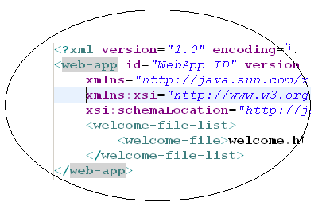

Simple Servlet Example: Folder structure
ServletDemos
WEB-INF
welcome.html
src
lib
web.xml
classes
edu
infy
servlets
HelloServlet.java
web.xml is a deployment descriptor. There has to be one deployment descriptor per web application placed in WEB-INF sub folder of Application root folder

Slide 26
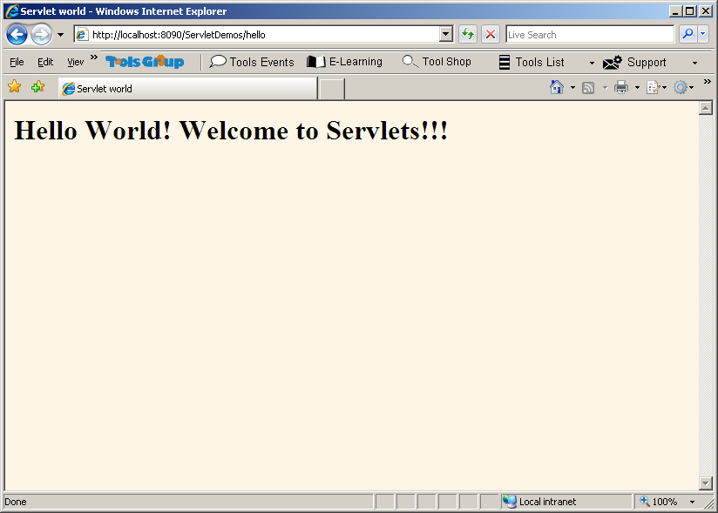
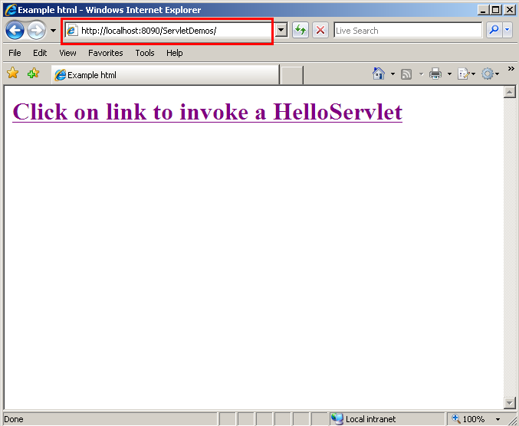
Make it Run…
Deploy it on the web container (tomcat)
Start the server
Open Internet Explorer -> Type the URL for the html resource
http://localhost:8080/ServletDemos/welcome.html
Click on the link given…
Watch for the output
Look at the URL…
Notes:
Deploying an application on to Application Server:
Here URL change from http://localhost:8080/ServletDemos/ to http://localhost:8080/ServletDemos/hello
Here ServletDemos is the project name and after click on link of welcome page(.html) it call to particular servlet which mapping is define in web.xml
For further reference:
http://tomcat.apache.org/tomcat-6.0-doc/appdev/deployment.html

Slide 27
What is the role of Servlet Container/Web Container? (E.g.-Tomcat)
Web container is a generic term used for Servlet container as well as JSP Container. Ex – Apache’s Tomcat, Resin
It provides following advantages, while developing web application using Servlet/JSP:
Communication Support : Provides easy way for the servlets to communicate with the web server
Lifecycle Management : Controls the entire lifecycle of the servlet:
loading of classes, instantiating it, initializing it, invoking lifecycle methods on it and afterwards, making it eligible for garbage collection
Multithreading support : Creates and manages a new Java thread for every servlet request it receives
Client -> request->webserver app-> Get -> web-container->get()->Servlet-> deplay
Declarative security
Notes:
It provides following advantages, while developing web application using Servlet/JSP:
Communication Support
Lifecycle Management
Multithreading support
Declarative security
JSP Support
Further reference to study more: http://www.onjava.com/pub/a/onjava/2003/05/14/java_webserver.html
Some web containers are
Apache’s Tomcat (most popularly used)
Resin

Slide 28
Application Server
Application Servers are specialized Web Server + Web Container + EJB Container
Application Servers provide all the system services to address non-functional requirements :
Scalability – through resource pooling
Security
Transaction management
Performance- connection pooling
Application developers can concentrate on functional requirements by coding required business logic
In n-tier architecture, an application server is a server that hosts an API to expose Business Logic and Business Processes for use by other
Notes:
We saw the enterprise application architecture, in which presentation logic and business logic reside in the middle tiers.
There can be different UI generation for different I/O devices, monitor, mobile devices, PDA.
For various applications lot of business rules will be coded in the business tier.
Business tier in turn talks to data access tier, where the connection establishment code will appear.
How many such connections need to be created? When? How to maintain this pool of open connections…
All these questions make the coding of middle tier bit complex.
It is seen that most of the times, same kind of questions need to be solved, when we are developing the enterprise application.
So, to reduce this complexity in middle tier , and give standardized interface to perform enterprise application development
These applications are developed on top of Application Servers.
Web definition of Application Server----→
In n-tier architecture, an application server is a server that hosts an API to expose Business Logic and Business Processes for use by other ... Visit -> en.wikipedia.org/wiki/Application_server

Slide 29
Application Server : JBoss
Java EE App Servers | Proprietary App Servers
Provide system services in well defined, open, industry standard manner | Provide system services in well defined, proprietary manner
Application development according to Java EE specification | Application development according to Application Server specification
Vendor independent | Vendor dependent
Ex: JBoss, Weblogic, Websphere | Ex: MS IIS
JBoss is open source, under LGPL
Full-fledged App Server built on J2EE 1.4 spec
Comes in 3 flavors: all, minimal and default
Notes:
Some of the most popular Java Enterprise Edition application servers :
WebSphere Application Server (IBM)
WebLogic Server (Oracle)
JBoss (Red Hat)
JRun (Adobe Systems)
Oracle OC4J (Oracle)
GlassFish Application Server (Sun Microsystems)
JBoss App Server has Tomcat embedded in it as its default Servlet Container

Slide 30
Servlet Lifecycle
Web Container
(1) Load class
HelloServlet
Deployed servlet
Eg: HelloServlet.class
Servlet Class
in memory
(4) Client makes request to the servlet:
service()
(2) Instantiate
(3) Initialize: init()
HelloServlet
HelloServlet
(5) Destruction:
After destruction, destroy()
Servlet Object
in memory
Servlet Object
destroyed
Notes:
The Servlet Container may create a Servlet object, when it receives the very first request for the Servlet;
But this is not always fixed, as one can configure the Servlet Container (anonymous to Web Container) for the Servlet creation at the time of startup of the Server itself etc.
A new Servlet object is NOT instantiated for each subsequent request
The Servlet Container will spawn a thread for each request to call the service method of the same Servlet object
This makes the Servlet technology faster and scalable

Slide 31
Servlets: the Request-Process-Response cycle
The client program (usually a web browser) makes a request to the web server either through the GET or POST method and asks for a service
The web server processes the client request and hands over the request to the servlet container when a client is requesting for servlet
The servlet container invokes the appropriate servlet based on the configuration details and passes the request object to the servlet for processing
The request object contains information about the client (for example: identity of the remote user, form data)
Status information, server information and the contents to be displayed on the client browser are sent via the response object
The servlet container ensures that the response is properly flushed and returns control back to the host Web server
Notes:
Servlets do not have main() method. They are under control of another Java Application called as Web Container.
Client →requests → Web Server → hands it over to→ web container → invokes the method on servlet to generate the response
Generated response → is passed from Servlet to → Web Container → which passes it to Web Server, → which in turn sends back to client
Configuration details are written in the deployment descriptor file, which is a web.xml

Slide 32
Deployment Descriptor: web.xml
<?xml version="1.0" encoding="UTF-8"?>
<web-app id="WebApp_ID" version="2.4" xmlns="http://java.sun.com/xml/ns/j2ee" xmlns:xsi="http://www.w3.org/2001/XMLSchema-instance" xsi:schemaLocation="http://java.sun.com/xml/ns/j2ee http://java.sun.com/xml/ns/j2ee/web-app_2_4.xsd">
<servlet>
<servlet-name>myFirstWorld</servlet-name>
<servlet-class>HelloWorldServlet</servlet-class>
</servlet>
<servlet-mapping>
<servlet-name>myFirstWorld</servlet-name>
<url-mapping>/hello</url-mapping>
</servlet-mapping>
</web-app>
Notes:
For web applications, the deployment descriptor must be called web.xml and must reside in a WEB-INF subdirectory at the web application root.
The deployment descriptor is an XML file that contains information on the configuration of the web application, including the configuration of servlets
Structure /Tags of DD for Servlets

Slide 33
Structure of DD
servlet tag:
The servlet tag as given in the above example has two mandatory sub tags, <servlet-name> and <servlet-class>. The servlet-class tag is the fully qualified name of the class that is to be executed and the servlet-name tag is an alias for use elsewhere within the deployment descriptor.
It may also have the following optional sub-tags:
display-name, init-param, load-on-startup, security-role-ref
servlet-mapping
The servlet mapping tag is a sub element of <web-app> and maps the logical name given to a servlet within the servlet tag to a url pattern. Without a servlet-mapping a servlet cannot be retrieved by a visiting browser.
Notes:
In the above example shown on the slide,
The HelloWorldServlet.java is the source code generated for the Servlet, its class would be in the classes folder.
It is deployed in the web application.
HelloWorld is a logical name given to this servlet, which is referred in the servlet-mapping…
Client will be able to access this servlet using the url pattern : http://localhost:8080/webappname/hello

Slide 34
What will Servlet do?
Process and/or store data submitted by an HTML form
Read form data sent by client (user) in the request
Read request headers
Generate / construct the response
Provide dynamic content e.g. returning the results of database query to the client
Manage state information for clients
As HTTP is stateless protocol, some applications would need to store information about the client until they logout e.g. online shopping cart
Notes:
Send the response:
Send actual data (result)
Send response headers and status code information

Slide 35
Get Form Data… Process… Respond…
Problem Definition:
loginForm.html accepts username and password, and passes it to Servlet, LoginServlet. LoginServlet has to verify if it is valid username in a Database.
If valid, display Welcome! Login successful!
If invalid, display Sorry guest ! Login failed!
Note: For Simplicity, we are not connecting to Database, whereas, we will check the username against a value. If it is “admin”, then it is valid.

Slide 36
loginForm.html
loginForm.html
loginForm.html
<html><head>
<title>Login Page</title>
</head>
<body bgcolor="#CCFFCC" >
<form action="Login" method="post">
<h2><center>Enter Login Details </center>
<br>
<table border="4" align="center" bordercolor="brown" bgcolor="pink">
<tr><td>UserName</td><td>
<input type="text" name="username">
</td></tr>
<tr><td><input type="submit" value="Login"/></td>
<td><input type="reset" value="Reset"/></td></tr>
</table>
</h2>
</form>
</body>
</html>

Slide 37
LoginServlet.java (1/2)
LoginServlet.java
LoginServlet.java
package edu.infy.servlets;
import java.io.IOException;
import java.io.PrintWriter;
import java.util.ArrayList;
/imports from javax.servlet package are done
//here
public class LoginServlet extends HttpServlet{
String message;
protected void doPost(HttpServletRequest request, HttpServletResponse response)
throws ServletException, IOException {
message = new String();
String username = request.getParameter("username");
if((username == null) || (username.length()==0)){
message="Username required field”;
}else{
if(username.equals(“admin”){
message=“Welcome! Login successful!”;
}else{
message=“Sorry guest, Login failed!!!”;
}
response.setContentType("text/html");
PrintWriter out = response.getWriter();
out.println("<HTML><HEAD><TITLE>Login Page</TITLE></HEAD><BODY BGCOLOR=\"#99CCFF\“>" +
"<H1> "+ message+" </H1></BODY>
</HTML>");
}

Slide 38
HttpServletRequest methods
getHeader()
getMethod()
getQueryString()
getRequestURI()
getRemoteUser()
HttpServletReponse methods
encodeURL()
sendError()
sendRedirect()
setStatus()
Notes:
This slide is For Your Reference slide…
For more info:
http://java.sun.com/products/servlet/2.2/javadoc/javax/servlet/http/HttpServletRequest.html
http://java.sun.com/products/servlet/2.2/javadoc/javax/servlet/http/HttpServletResponse.html

Slide 39
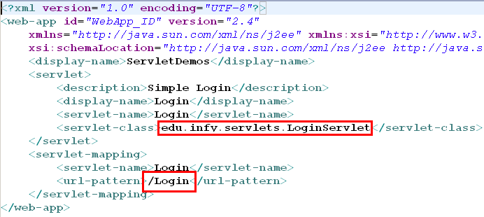
web.xml

Slide 40
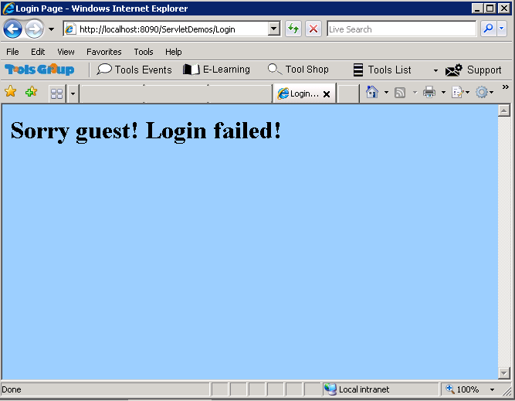
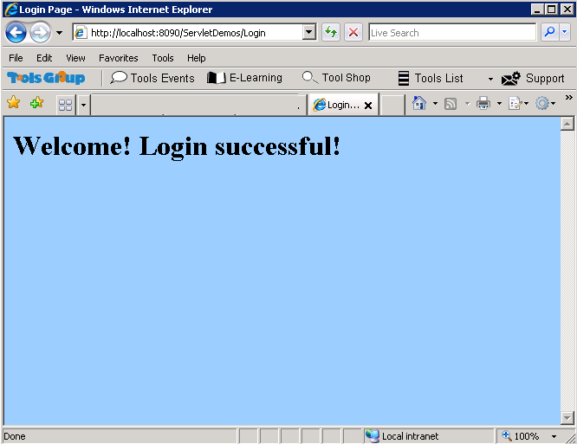
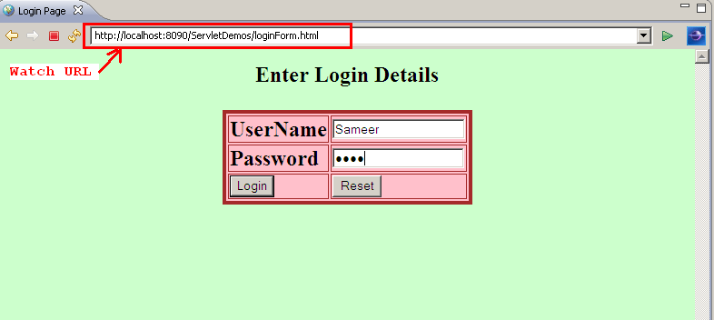
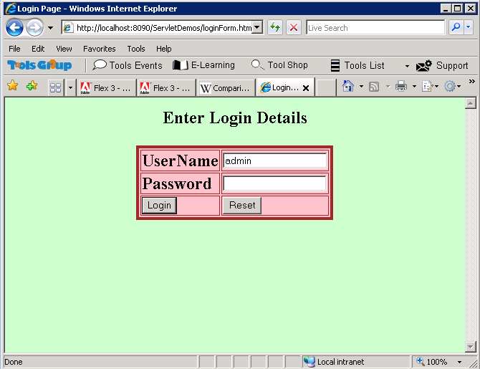
Result

Slide 41
Server-side validations
What if data for username and password are left blank and form is submitted?
How will you make sure that user has entered all mandatory fields on the form before submitting it?
Answer – JavaScript
But this is client-side validations, and user can disable JavaScript from the web browser settings
So, we need to check it at server-side too…
Checking whether the data given for the parameter is zero-length or null are must Server-side validations

Slide 42
Scope of Servlets in web application
Servlets are nothing but Java code having bits of HTML
HTML is the presentation language for client
Mixing Java code and HTML in servlet leads to-
Tight coupling between presentation and business logic
Difficulty in maintaining, managing code
Any change in the presentation needs a change in servlet
Any change in the business rules needs changing module which contains presentation logic
We need a technology which helps us to write/maintain server-side presentation logic easily…. JSP!!!

Slide 43
Can you answer these Questions?
How will the client invoke any servlet?
Through a URL
In which file do you associate a servlet with the URL?
In web.xml, using <servlet-mapping> element
The web container receives 10 requests for a HelloWorld servlet. How many instances of HelloWorld servlet will be created by the Container?
Only One instance
Notes:
.

Slide 44
Can you Answer these Questions?
If the servlet’s init method throws an Exception, will requests to that servlet be serviced by the container?
No. Results in HTTP 500 error. All requests can be serviced only once the init method returns successfully
Can we have instance variables in servlets? Are they
thread-safe?
Yes, Servlets can have instance variables. No, They are NOT thread-safe. All requests to a servlet share the same instance
Servlets are used for coding which layer of the enterprise application?
Presentation Layer

Slide 45
Summary
Java Platform, Enterprise Edition (Java EE) is the industry, open standard for developing portable, robust, scalable and secure server-side Java applications
A Java EE App Server takes care of the non-functional requirements of a Java EE application
Java EE provides two technologies Servlet and JSP to develop the server side presentation logic
As a good programming practice, presentation logic and business logic need to be separated
45

Slide 46
Summary
Servlets are difficult to maintain by the page authors/ web designers
Web designers would be maintaining the presentation logic and hence Sun Microsystems offered JSP technology which is as simple as HTML and as powerful as Servlets

Slide 47

Folder Structure of the Web Application
Application
Root
WEB-INF
Html pages
classes
lib
web.xml
src
External
libraries
Packaged servlets
Notes:
Web Application Directory Structure:
Application Root: Every web application will have a root folder (Application root) which is usually called as context root, under which lies all other application specific resources as either folders or files. The name of this root folder is called as context. As many applications can be deployed in a single web container/application server the server uses the context name to decide as to which application the request has come for and accordingly handles it.
WEB-INF: WEB-INF is a mandatory folder that should be present directly below the context root. It contains metadata about the application. The container looks in this folder to find resources like:
web.xml: The application's deployment descriptor file. It is a mandatory XML file for all JEE applications and should be placed directly under WEB-INF folder. It contains markup describing the attributes of the application. The application server reads this file during initialization of the application.
Java Class files: If the application references any java classes then the container will look for those java classes in the “classes” folder which if present should be directly under WEB-INF or bundled in a jar file under lib folder. Both classes and lib folders are not mandatory.
Jar files: All the jar files required for an application should be placed under lib folder, which is present directly under WEB-INF.
Resources placed under WEB-INF can not be directly accessed by client (i.e., by typing their URL) .
src folder: This folder houses the java source files developed as part of the application. This folder present under WEB-INF, usually, will be used only during the time of development and may not be present in a deployed application.
Note: All resources which the clients can directly access (i.e. all the static and dynamic content like html/images/text-files/jsp) should be placed directly under the context root or in a sub-folder other than the standard folders(WEB-INF).
All standard folders and files like WEB-INF, classes, lib and web.xml are case-sensitive and the application server looks for a folder/file of that particular case only.

Slide 48
asf

Slide 49
Compresser for Java App
In J2EE application modules are packaged as EAR, JAR and WAR based on their functionality
JAR: EJB modules which contains enterprise java beans class files and EJB deployment descriptor are packed as JAR files with .jar extenstion
WAR: Web modules which contains Servlet class files,JSP FIles,supporting files, GIF and HTML files are packaged as JAR file with .war (web achive) extension
EAR: All above files (.jar and .war) are packaged as JAR file with .ear (enterprise archive) extension and deployed into Application Server.
Notes:
WAR file goes into web container of Java EE application server. Web container hosts web applications based on JSP/Servlets API
EJB module to be packaged in JAR file having ejb-jar.xml file in META-INF folder. Enterprise applications are packaged in EAR file that is special JAR file containing application.xml file in META-INF folder. it has a special directory called APP-INF that contains the application.xml file

Slide 50
XML
Xmlns(XML namespace) attribute is the start tag of an element
Syntax : xmlns:prefix="URI ".
default namespace for an element saves us from using prefixes define as xmlns="namespaceURI“
XSLT is an XML language that can be used to transform XML documents into other formats, like HTML.
The tags that are not HTML tags have the prefix xsl, identified by the namespace xmlns:xsl="http://www.w3.org/1999/XSL/Transform"
Xmlns:xsi is the XML schema instance namespace
It xmlns:xsi is available then we can use schemaLocation attribute. As below xsi:schemaLocation="http://www.springframework.org/schema/beans http://www.springframework.org/schema/beans/spring-beans-3.0.xsd“
It has 2values separated by space:- 1st for schema namespace and 2nd is location of XML schema

